Slide 1
Chapter 16 Part 2
Logic Programming Languages

Slide 2
Chapter 16 Topics
The Origins of Prolog
The Basic Elements of Prolog
Terms
Fact Statements
Rule Statements
Goal Statements
Prolog Inferencing Process

Slide 3
The Origins of Prolog
Development started in early 1970s
University of Aix-Marseille
Alain Colmerauer and Phillippe Roussel
Natural language processing
University of Edinburgh
Robert Kowalski
Automated theorem proving
Two main dialects exist
We will use Edinburgh syntax

Slide 4
Prolog: Terms
Term
A constant, variable, or structure
Constant
An atom or an integer (e.g. 42)
Atom
A symbolic value in Prolog
Consists of either
A string of letters, digits and underscores starting with a lowercase letter (e.g. joe)
A string of any printable ASCII characters delimited by apostrophes (e.g. 'Some Atom')
Notes:
A symbolic value is an object we are reasoning about.

Slide 5
Prolog: Terms
Variable
String of letters, digits, and underscores starting with uppercase letter (e.g. X or MyVar)
Instantiation: Binding a variable to a value
Only happens during the resolution process
We’ll return to this later
Structure
Represents an atomic proposition
Syntax
functor(parameter list)

Slide 6
Prolog: Statements
Three kinds of statements
Fact statements
Rule statements
Goal statements

Slide 7
Prolog: Fact Statements
Fact statements
Atomic propositions used for the hypotheses
Structures representing headless Horn clauses
Examples
female(shelley).
female(anna).
male(bill).
father(bill, jake).
Notes:
We’ve looked at atomic propositions before. Fact statements are represented and interpreted in the same way.

Slide 8
Prolog: Rule Statements
Rule statements
Used for the hypotheses
Headed Horn clauses
Right side: Antecedent (if part)
May be single term or conjunction
Form of conjunction
Several terms separated by commas
Logical AND operators are implied
Left side: Consequent (then part)
Must be single term

Slide 9
Prolog: Rule Statement Examples
A specific rule (using atoms):
ancestor(mary,shelley) :- mother(mary,shelley).
General rules use variables (universal objects):
parent(X,Y) :- mother(X,Y).
parent(X,Y) :- father(X,Y).
grandparent(X,Z) :- parent(X,Y), parent(Y,Z).
sibling(X,Y) :- mother(M,X), mother(M,Y),
father(F,X), father(F,Y).
Notes:
Logical “and” operators are represented using commas. A logical implication is specified using the :- notation. Implications work from right to left, so the right hand side of :- represents the antecedent, and the left hand side represents the consequent.
The first rule should be read as follows:
If mary is the mother of shelley, mary is the ancestor of shelley.
Note that specific rules are less useful than general rules, because general rules can reason about facts, while specific rules are just statements about facts.
The second set of rules:
If X is the mother of Y, then X is also the parent of Y.
If X is the father of Y, then X is also the parent of Y.
If X is the parent of Y, and Y is the parent of Z, then X is also the grandparent of Z.
If M is the mother of X, and M is the mother of Y, and F is the father of X, and F is the father of Y, then X is also the sibling of Y.
A logical or is not explicitly represented, but is implied by separate rules with the same antecedent, but different consequents.

Slide 10
Prolog: Goal Statements
Goals or queries are used in theorem proving
A theorem
A proposition Prolog must try to prove
A simple goal uses the syntax of a fact statement
Example (the ?- is a prompt Prolog often uses)
?- man(fred).
Conjunctive propositions and propositions with variables are also legal goals
?- father(X,mike).
?- father(X,mike), male(X).
Conjunctive propositions made up of subgoals
Notes:
In the case of man(fred), you are asking Prolog “Can you prove that fred is a man?” Prolog will respond with either “true” (meaning that it can prove this query holds), or “false” (meaning that Prolog can’t prove the query holds). Note that a “false” doesn’t necessarily mean that the query does not hold, just that Prolog can’t prove it given the facts and rules it has. Prolog may not be able to prove a query holds if you haven’t given it the facts or rules necessary to prove the query.
In the case of father(X,mike), you are asking Prolog “Can you find an X so that X is the father of mike?” If Prolog can’t find an X to make the query hold, it will immediately respond with “false”. If Prolog can find an X to make the query hold, it will respond with “true” and a value of X that makes the query hold. You can re-query Prolog, which means “Can you find another X so that X is the father of mike?” You can continue querying for a new X until Prolog can’t find any more values for X that make the query hold. Once this happens, Prolog responds with a “false”.
You can have multiple sub-queries, where each sub-query is separated by a comma (because all sub-queries must be proved to hold, a comma again represents a logical “and”).

Slide 11
Prolog: Inferencing Process
To prove a goal or subgoal is true
Must find a chain of facts and rules
For goal Q, find fact A, such that
B :- A
C :- B
…
Q :- P
This process is called matching
Proving a subgoal is called satisfying the subgoal

Slide 12
Prolog Inferencing Process: Approaches
Bottom-up resolution, or forward chaining
Begin with facts and rules
Attempt to find a sequence of matches that leads to goal
Works well with a large set of possibly appropriate facts
Top-down resolution, or backward chaining
Begin with goal
Attempt to find a sequence of matches that leads to facts
Works well with a small set of possibly appropriate facts
Prolog uses this approach
Compare bottom-up and top-down resolution
father(bob).
man(X) :- father(X).
?- man(bob).
Notes:
If forward chaining is used, we start with the facts. There is only one fact, so we start with:
father(bob).
Now we try to find a rule that will make man(bob) true. We find the rule:
man(X) :- father(X).
And can substitute bob for X, because this produces:
man(bob) :- father(bob).
and we already know that father(bob) holds. We see that we’ve established that man(bob) also holds, because of the rule, and we conclude that the query does hold.
========
If backward chaining is used, we start with the goal:
man(bob).
Now we want to find a path to a fact. We look at the rules first, and find:
man(X) :- father(X).
and can substitute bob for X because we have assumed that man(bob) holds. So we get:
man(bob) :- father(bob).
From this rule, we see that father(bob) must hold if man(bob) holds. Now we’ve found a path from the query to a fact, so the query must hold.

Slide 13
Prolog Inferencing Process: Subgoals
When goal has multiple subgoals, can use
Breadth-first search
Work on all the subgoals in parallel
Depth-first search
Find a complete proof for the first subgoal before working on the others
Can be done with fewer computational resources
Prolog uses this approach

Slide 14
Prolog Inferencing Process: Backtracking
Backtracking
Multiple subgoals, and we fail to prove one
Reconsider previous subgoal for different solution
Begin search where previous search left off
Can take lots of time and space
May find all possible proofs to every subgoal
Consider the goal
?- male(X), parent(X,shelley).
Instantiates first X that is male, then tests if X is shelley’s parent.
If not, backtrack and try another X.
Notes:
Prolog always works from left to right when trying to prove sub-goals, and top to bottom when matching facts.
Given the last example, Prolog will end up searching for a long time if there are a lot of male(…) facts. The worst case scenario is if there is no fact (or rule) supporting that shelley has a male parent. In that case, all males will have to be checked before Prolog can respond with a “false”.
Can we solve this problem? If we restate the goal as follows:
parent(X,shelley), male(X).
Prolog will first try to find an X that is a parent of shelley, and then test whether that parent is male. If we assume that any person will have a maximum of two parents, this means Prolog will have to go through a maximum of only two instantiations for X before either finding an object that satisfies the subgoals, or concluding that it can’t prove the goal.
Note that this breaks Prolog’s context independence, because it should not matter which order the subgoals appear in.

Slide 15
Prolog Inferencing Process: Tracing Model
Prolog has a built-in trace structure
Displays variable instantiations at each step
Tracing model of execution has 4 events
Call (beginning of attempt to satisfy goal)
Exit (when a goal has been satisfied)
Redo (when backtracking occurs)
Fail (when goal fails)

Slide 16
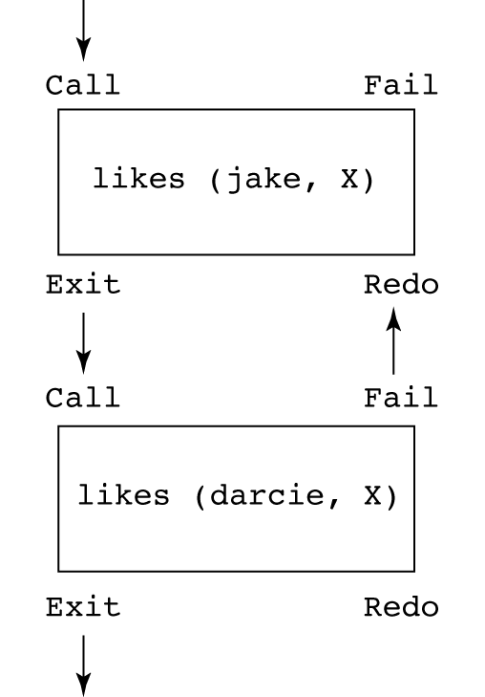
Prolog Inferencing Process: Tracing Model Example
likes(jake, chocolate).
likes(jake, apricots).
likes(darcie, licorice).
likes(darcie, apricots).
trace.
likes(jake, X), likes(darcie, X).
1 Call: likes(jake, _0)?
(1) 1 Exit: likes(jake, chocolate)
(2) 1 Call: likes(darcie, chocolate)?
(2) 1 Fail: likes(darcie, chocolate)
1 Redo: likes(jake, _0)?
(1) 1 Exit: likes(jake, apricots)
(3) 1 Call: likes(darcie, apricots)?
(3) 1 Exit: likes(darcie, apricots)
X = apricots
Notes:
This example illustrates the steps Prolog goes through to prove a query. Prolog always works from left to right, and top to bottom when trying to prove a query holds.
The query is attempting to find an X that both jake and darcie like. The basic approach is as follows:
Prolog starts with the leftmost sub-goal. It needs to find an instantiation for X that makes likes(jake, X) true.
Prolog starts searching for a fact from the top. The first fact it finds is likes(jake, chocolate), so X is instantiated to chocolate.
The first sub-goal has been satisfied, so Prolog moves on to the second sub-goal, likes(darcie, X). Because X has been instantiated to chocolate, the second sub-goal to prove is likes(darcie, chocolate).
Prolog searches for a matching fact, but can’t find anything.
Prolog must now backtrack to the previous sub-goal, and try to find another X that makes likes(jake, X) true. The search continues from where the first sub-goal was satisfied.
The next matching fact is likes(jake, apricots), so X is instantiated to apricots.
Prolog now moves to the second sub-goal, likes(darcie, X), which becomes likes(darcie, apricots) because X has been instantiated to apricots.
Prolog finds likes(darcie, apricots), which satisfies the second sub-goal.
We have no further sub-goals to satisfy, so Prolog responds with “X = apricots”.
If we were to re-query Prolog after this process, no further instantiations for X can be found to satisfy the first sub-goal, so Prolog responds with “false”.

